Slide 1
Agentic AI @ Adobe
Tudor Coman | Sr. Machine Learning Engineer, Agent Orchestrator
Ovidiu Taraleșca | Sr. Machine Learning Engineer, Agent Orchestrator

Slide 2
Agenda
Presenter | Section | Time
Tudor & Ovidiu | Introductions | 5’
Tudor | Claude Code Best Practices | 20-25’
Ovidiu | Agent Orchestrator Ecosystem | 20-25’

Slide 3
Claude Code

Slide 4
What is Claude Code?
The third generation of AI Coding tools, alongside Codex and Cursor
  First Generation: Assistive (Copilot)
  Second Generation: Conversational (Copilot Chat, earlier versions of Cursor)
  Third Generation: Agentic
CLI tool developed by Anthropic to harness the maximum potential of their high-performance models such as Opus and Sonnet

Slide 5
Tooling evolution
Q: What made the shift from conversational to agentic/autonomous coding tools possible?
Context window increases (4K -> 100K -> 1M tokens)
Release of Model Context Protocol (MCP) by Anthropic

Slide 6
Context Management
Before
RAG was a good solution for small context window models, by chunking and embedding the data for later retrieval, however…
Retrieval can miss important context
Chunking breaks structure
Extra complexity in terms of processing time & infrastructure
Now
Models can directly process entire codebases and documents with a 1M context window
Instead of leaving the LLM the freedom to search the entire codebase and determine underlying patterns, both Codex and Claude support automatic context injection using markdown files (CLAUDE.MD)

Slide 7
Model Context Protocol
A standard way for AI to connect to: codebases, APIs, DBs, tools (Github, CI, CLI etc.)
This enables agentic workflows, by reducing the need of manual orchestration by developers
Scenario: fixing a failing test
Without MCP | With MCP
Check CI logs manually Copy error into an LLM AI suggests a fix Edit the code manually Validate the fix worked If it didn’t, repeat | The LLM can automatically execute the CI command and read the logs Has access to all the relevant files Identifies the failing test and the root cause Makes the necessary edits and runs the code

Slide 8
And of course… the prompt!
A bad prompt will never get you the desired result regardless of how much context and tooling you have in-place
What makes a prompt good?
Name the place where you want to make a change (filename, module etc.)
One scope at a time – never ask an LLM to make 10 different changes
Give a concrete example of the desired behavior after the change
(Optional) Point to existing code for reuse – this might be discoverable from the context but not always

Slide 9
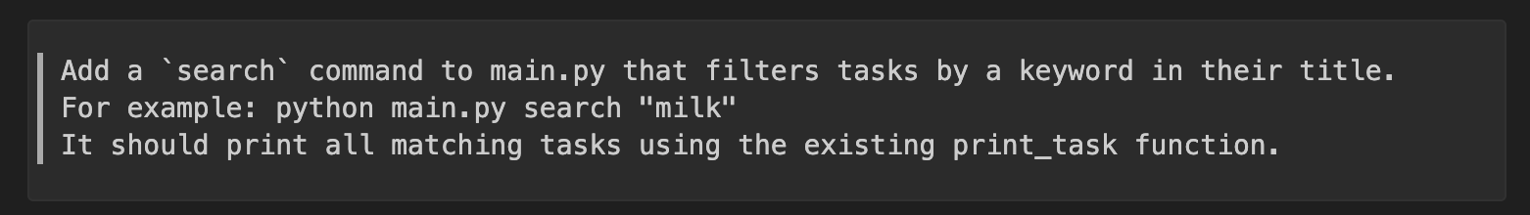
Large Quote
  A good prompt

Slide 10
Taking prompts one step further
The Anthropic team figured out many developers use the same prompts over and over again
For this reason, they added a special feature to Claude Code: skills
Skills = frequently used prompts stored in .claude inside your project and ran as commands inside Claude Code

Slide 11
Summing things up
Agentic AI is now a full-time resident in the software development lifecycle
Now that we have capable LLMs, leverage this by maximizing the context given to your AI tools
Take this a step further by connecting your tools to MCP servers for unlocking more context
Last but not least, work on your prompts! And use your most common used prompts as skills

Slide 12
Claude Code in Action

Slide 13
Agent Orchestrator

Slide 14
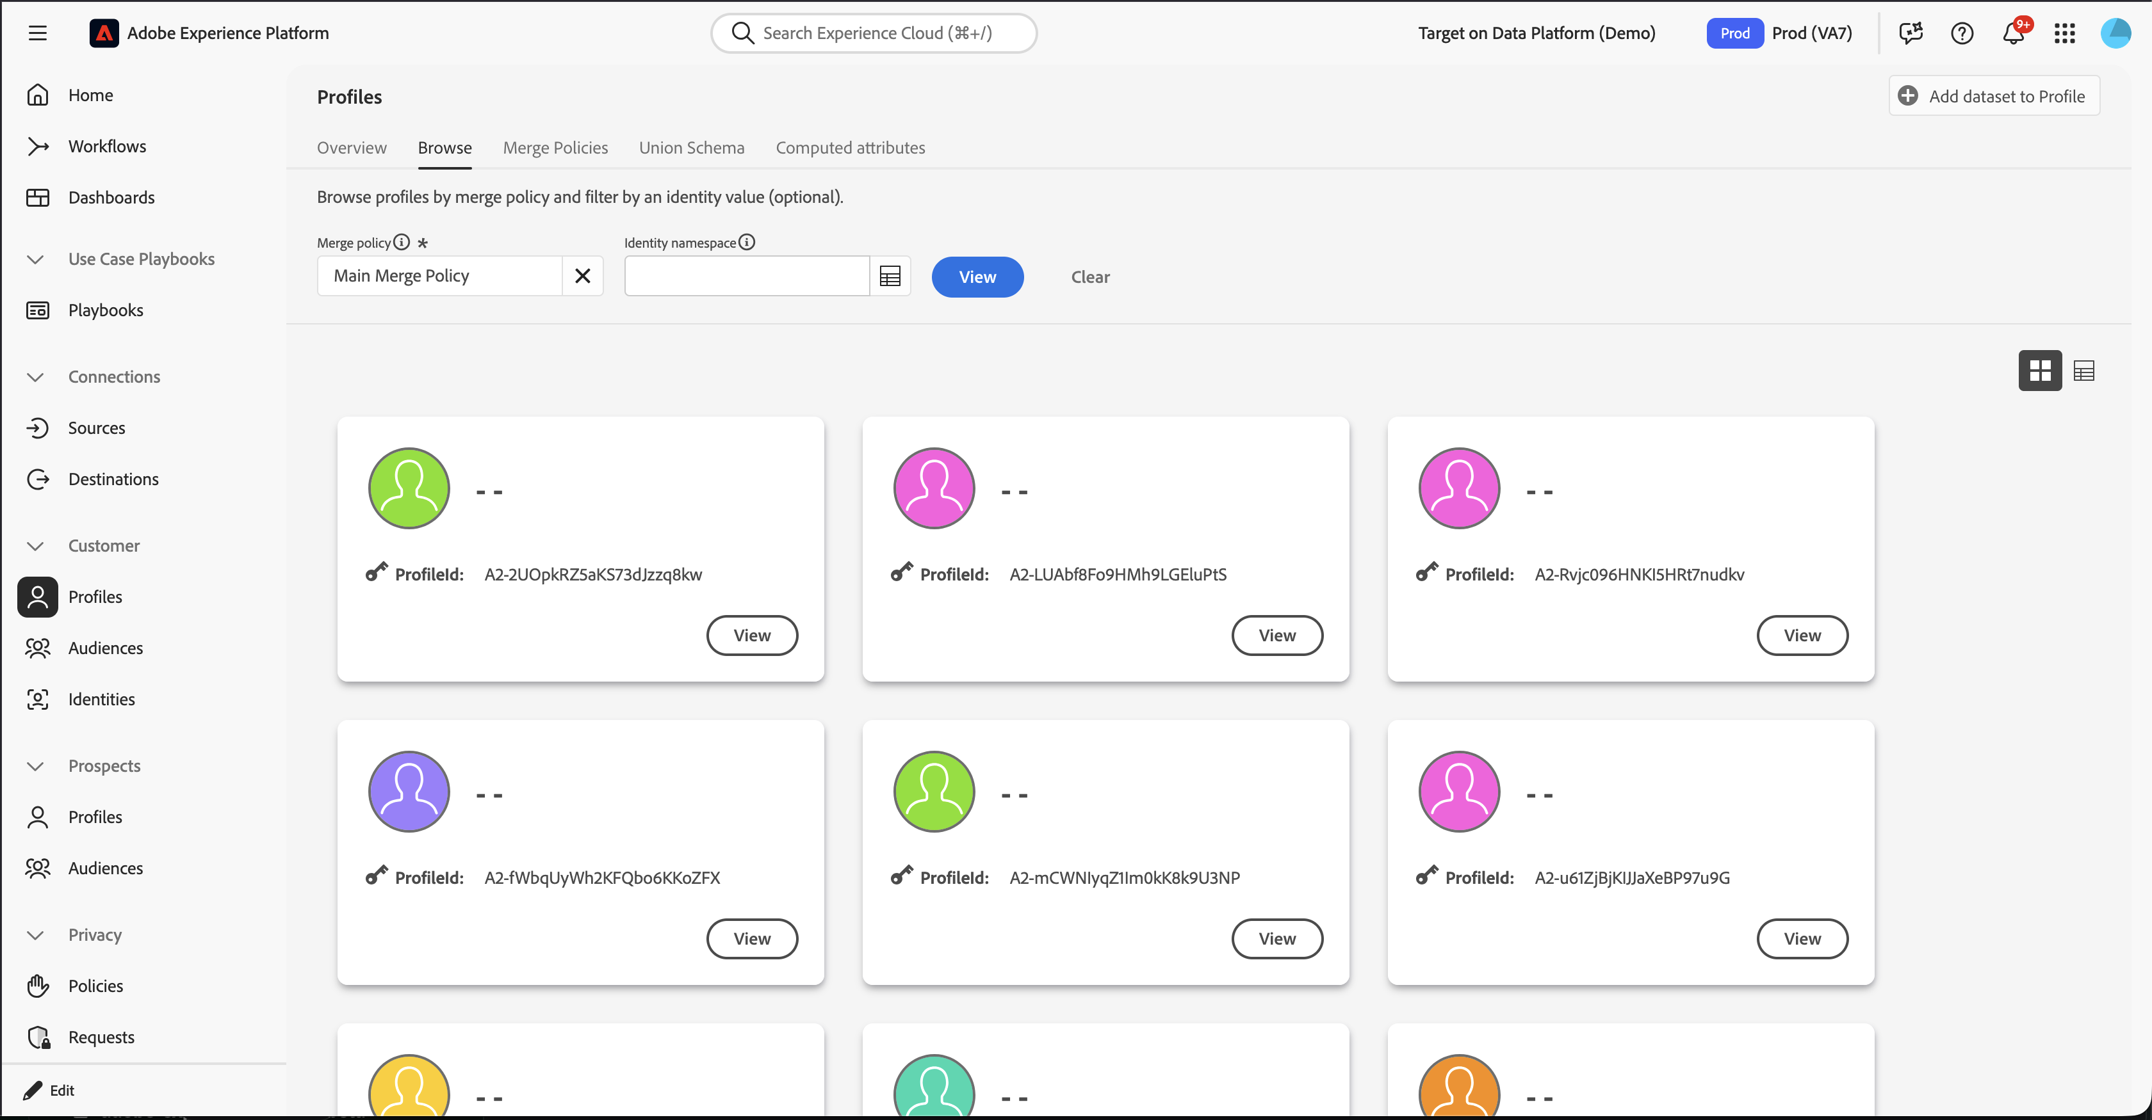
What is ”Enterprise SaaS”?
Think Photoshop-level complexity software, with Enterprise customers data.

Slide 15
Today’s Enterprise SaaS Stack in Adobe
SaaS Product Knowledge
Customer Context
Challenges:
Extensive product and domain knowledge required to operate SaaS; Consulting often needed.
Additionally, Customer organizational knowledge and context required for successful outcomes.
Multiple UI experiences and siloed workflows
UI
UI
UI
API Gateway
APIs
Cloud Services
Compute
Governance, Security, Privacy
Data Lake
Pipelines
Databases
(K/V, Relational, …)

Slide 16
Does an Agentic Application simplify user experience?
Natural Language
Vision of Agent Orchestrator…
Simplifies product interactions; Agents can use product and customer knowledge as context.
Eliminates vertical UIs and siloed workflows; end-to-end tasks done in single conversational interface
Automates discovery and integration of new agents
Agent Orchestrator
Enterprise Agents
Customer Agents
API Gateway
Product
KBases
APIs
Customer
Context
Cloud Services
Compute
Governance, Security, Privacy
Data Lake
Pipelines
Databases
(K/V, Relational, …)

Slide 17
Why can’t we have a single agent?
Reasoning Engine
Plan Generator
Agent Orchestrator
…
Create and manage audiences
Customer Journey Analytics Questions
Audience Agent
Data Insights Agent
Detect & raise issues with websites
Enhanced support & troubleshooting
Draft & Created Journeys
Site Optimization Agent
…
Product Support Agent
Journey
Agent
Analyze & optimize experiments
Experimentation Agent

Slide 18
The Agent Orchestrator Stack
Single Conversational Interface
Reasoning Engine
Executor
Planner
Agent Orchestrator
…
Natural Language Description
Multimodal input
Natural Language Description
Multimodal input
Natural Language Description
Multimodal input
…
Agent A
Agent B
Agent C
Team A
Team B
Team C

Slide 19
Agent Orchestrator is a dynamic orchestration engine
Dynamically Orchestrates multiple agents to solve user tasks
Generates prompt-specific Plans
Compiles and Executes Plans using available Agents
Backtracks & Re-plans when issues encountered
Reasoning Engine
Plan Generator
Agent Orchestrator
…
Create and manage audiences
Customer Journey Analytics Questions
Audience Agent
Data Insights Agent
Detect & raise issues with websites
Enhanced support & troubleshooting
Draft & Created Journeys
Site Optimization Agent
…
Product Support Agent
Journey
Agent
Analyze & optimize experiments
Experimentation Agent

Slide 20
Anatomy of Agent Orchestrator
Generate plan
Reasoning Engine:
  Detects intent (planning, direct agent execution)
  Invokes agents according to plan,
  Verifies results and backtracks if necessary
Plan Generator:
  Selects prompt-specific plan from corpus
  Compiles plan against available agents
Reasoning Engine
Plan Generator
Backtracking
Plan
Execute
Verify
Generated Plan
Adobe Models
Reference
Plans
Compiled Plan
Partner Agents
Partner Agents
Partner Agents
Partner Agents
Partner Agents
Partner Agents
Adobe Agents
Partner Agents
Customer Agents

Slide 21
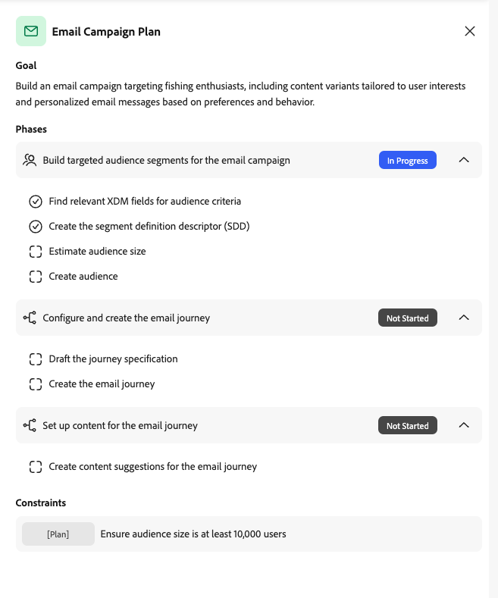
How do we plan?
Goal
Summary of the user objective
Phases
High level jobs to be done
Steps
Atomic task, grounded in operators
Constraints
Important validation or verification criteria

Slide 22
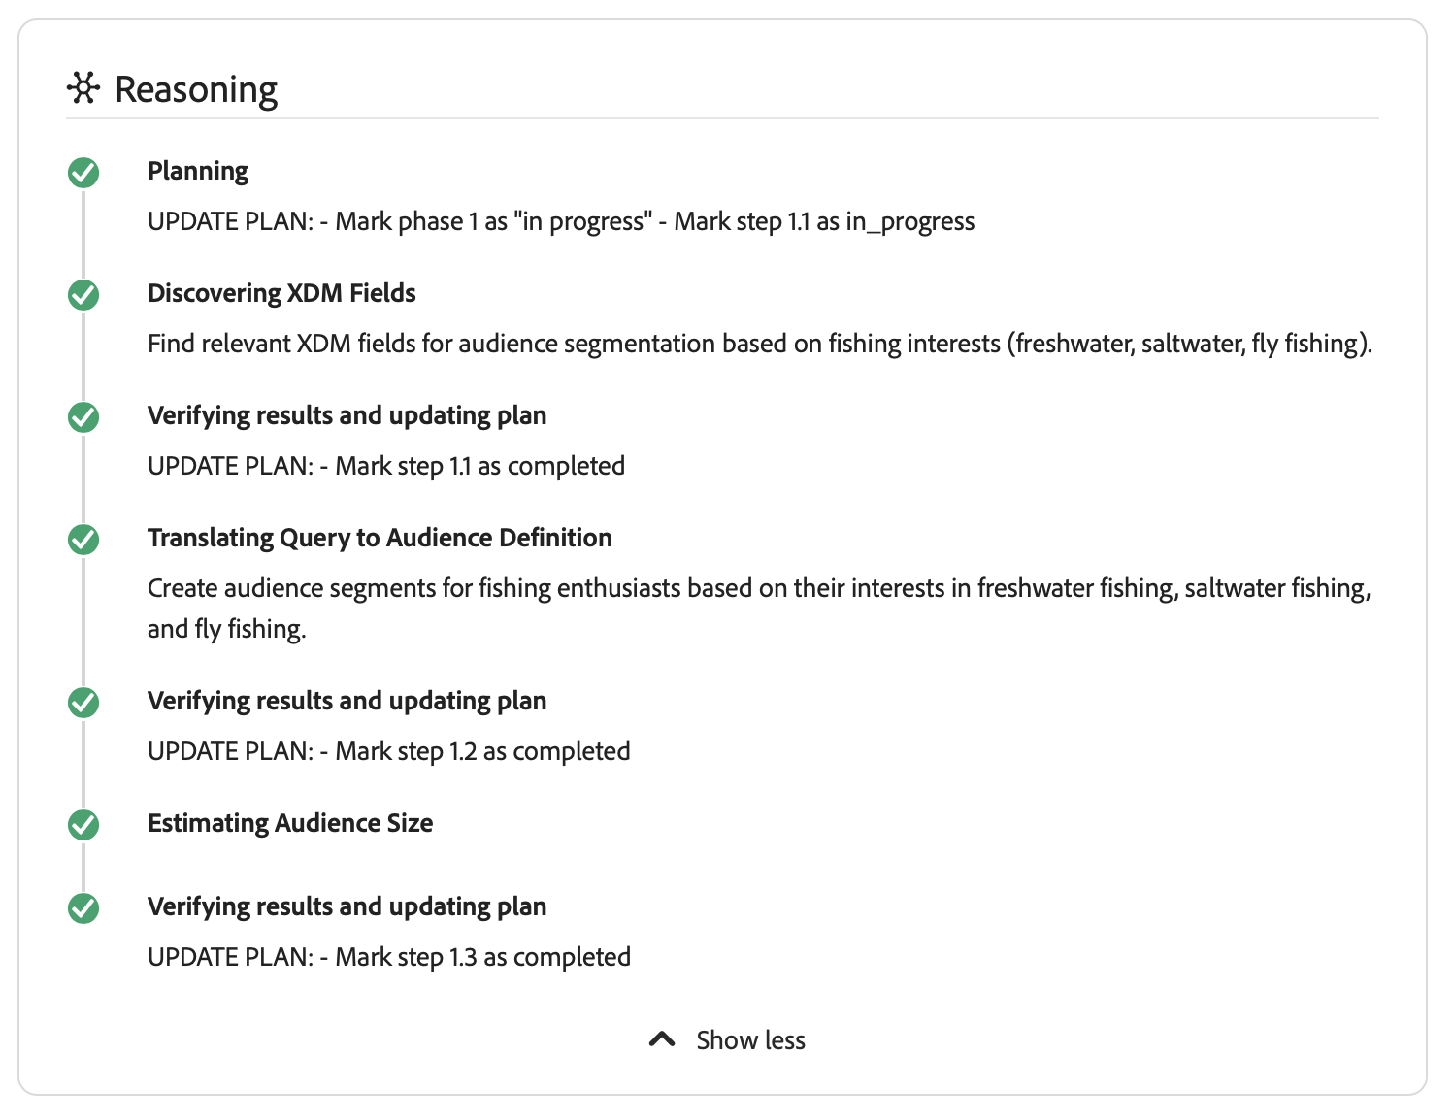

Plan Execution: Orchestrating multiple agents
Approval
Executor
Plan Generator
Execute, Verify & Backtrack,
with Human-in-the-loop
Agent Orchestrator
Business objects and lineage
Find Data Insights
Find relevant XDM fields
Operational Insights Agent
Draft, Estimate, Create Audiences
Agents perform each step
Data Insights Agent
Field Discovery Agent
Audience Agent
Draft & Created Journeys
Conceptual knowledge from product docs
Journey
Agent
Product Knowledge Agent

Slide 23
Real World Journey Example
“I want to launch a new journey aimed at engaging recently signed up customers with an appealing credit card offer of no annual fee and do so across both mobile and email platforms. Start with the mobile channels (sms or push) and if the user does not engage within 7 days, then follow up with an email.”

Slide 24
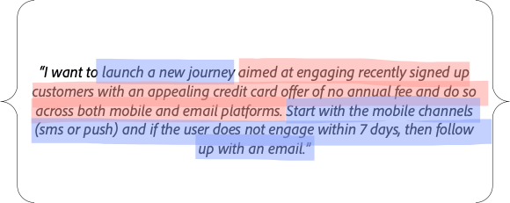
Journey Example
User
2
"We found an audience that matches your description called Product X Holders. Would you like me to use that one? " Data: audience_id=WG12823G234
5
"We are able to create an audience-based journey using the following configuration. Shall I PROCEED?
Agent Orchestrator
1
"Check to see if an existing audience can be found matching the description of profiles with an appealing deposit/credit card offer X pending in their account and have used product Y in the last 39 days."
3
4
6
“Create an audience-based journey that targets audience ID WG12823G234 and targets Push. If the user does not engage within 7 days, follow up with an email.”
“Create the content for sms, push and email channel.”
“Personalize the content based on Profile attributes
Audience Agent
Journey Agent
Content Agent
Personalization Agent

Slide 25
Audience Creation Example
“I want to create a new audience for customers in California
between age 18 - 39 with minimum account balance of $1000
and who have more than 2 deposits in last month.”

Slide 26
Audience Creation
Example
User
4
6
7
2
"We found the following relevant fields for creating an audience definition. Are these correct" Data: <LIST OF RELEVANT FIELDS>. Would you like to create an audience?
"We are able to create an audience. Would you like to estimate its size?
"The audience has 86753 customers. Would you like me to save the audience?
"See your newly saved audience http://link-to-audience"
Agent Orchestrator
1
3
5
6
Using the following fields, “Create a new audience for customers in California between age 18 - 39 with minimum account balance of $1000
and who have more than 2 deposits in last month.”
Data: <LIST OF RELEVANT FIELDS>
"Estimate size for audience.
Save audience...
Find fields needed to create a new audience for customers in California between age 18 - 39 with minimum account balance of $1000
and who have more than 2 deposits in last month.”
Field
Discovery Agent
Knowledge Based Audience Agent

Slide 27
Closer Slide

